Slide 1
Credit Card Fraud Detection
Shelagh Haney, Ryenn McAdory, Andrea Scherben
Northwestern University | MSDS 422

Slide 2
Executive Summary
Designing a Machine Learning pipeline to identify real-time financial fraud while minimizing false-alarms
The Problem
Fraudulent transactions are incredibly rare, but missing them carries massive financial and reputational risk
The Process
Reviewed the data structure, transformed data, and prepared the dataset for machine learning models
The Solution
Built models that detect fraud while limiting false alarms

Slide 3




Why Fraud Matters
Protect revenue, ensure compliance, and strengthen trust
Reduce Excessive Losses
Improve Customer Experience
Detect suspicious activity earlier
Lower chargebacks & recovery costs
Protect financial performance
Reduce false declines
Support smoother transactions
Strengthen customer trust
Effective fraud detection creates value by improving security and reducing Disruption
Icons Source: https://fonts.google.com/icons

Slide 4
Objectives
Building a model that captures fraud while minimizing false positives
Find Signals
Which features drive fraud, and does our engineered time feature add value?
Tune the Threshold
Find the sweet spot between catching fraud and minimizing false alarms
Deployment Strategy
Recommend a practical path to score transactions in near real time
Compare Models
Build and compare at least four models
Quantify Impact
Translate model accuracy into dollars saved and costs avoided
1
2
3
4
5

Slide 5





What Does the Data Look Like?
A snapshot of credit‑card activity, fully anonymized for privacy
284,807
transactions
0.17%
fraud rate
492
fraud transactions
30 predictors
Time, Amount, V1-V28 features
48 hours
transaction window

Slide 6
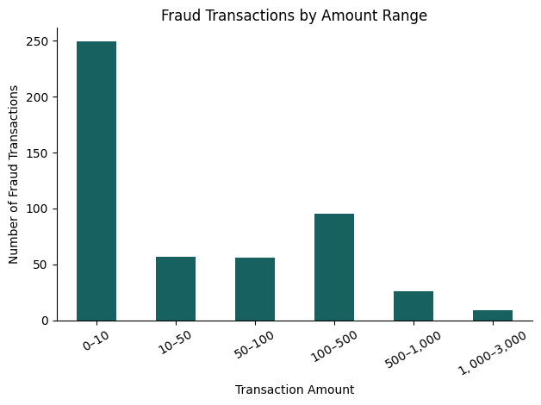
Data Insights
What the Transaction Log Shows
51%
of fraud transactions were less than $10
$2125
Is the maximum fraudulent transaction

Slide 7
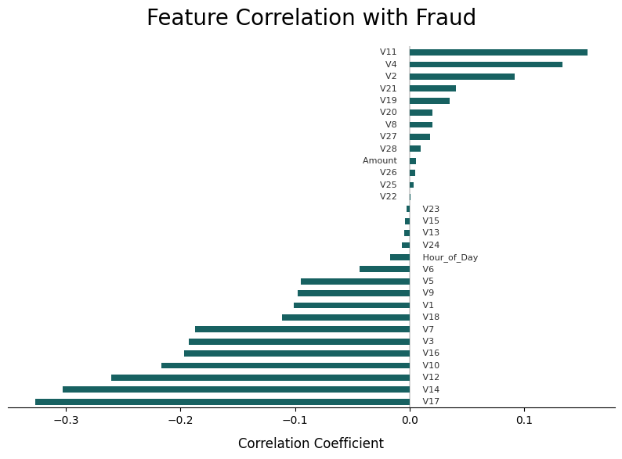
Key Drivers of Fraud
The strongest anonymized variables (V‑numbers) that have the greatest influence on fraudulent activity.
Identifying the Signals
Because the dataset is fully anonymized for privacy, we must rely on correlation
Positive and Negative Predictors
These gives our models the mathematical blueprint needed to detect organized attacks

Slide 8
Preparing the Data
Turning raw transaction logs into a trustworthy, model‑ready dataset
Preserving
What we did: Retained duplicate transactions and large monetary outliers
Why it matters: Duplicates and outliers demonstrate real-world patterns
Transforming
What we did: Evaluated and engineered features to maximize predictive signal
Why it matters: Ensures the models receive the most informative version of every variable
Splitting
What we did: Isolated testing data before doing any modeling
Why it matters: Guarantees that we can test accuracy of the models

Slide 9
Methodology and Tools
Building a simple, fast Fraud-Detection pipeline
Tooling
Built within a notebook environment (Colab)
Developed in Python 3 using pandas, scikit-learn, and Matplotlib
Relied entirely on CPU-based training
Evaluation
Standard accuracy is misleading in this dataset
Primary metric: PR-AUC
Decisions
Class imbalance handling
Threshold as a business lever
Small-Sample caveat

Slide 10
Models Evaluated
Choosing the right algorithm for a rare-fraud problem
Logistic Regression (LR)
transparent baseline that ensures rare fraud cases aren’t ignored
K-Nearest Neighbors (KNN)
captures unusual fraud patterns without any data‑shape assumptions
Linear Discriminant Analysis (LDA)
checks to see how strict assumptions affect performance
Quadratic Discriminant Analysis (QDA)
flexible model that lets each class have its own shape/variance

Slide 11
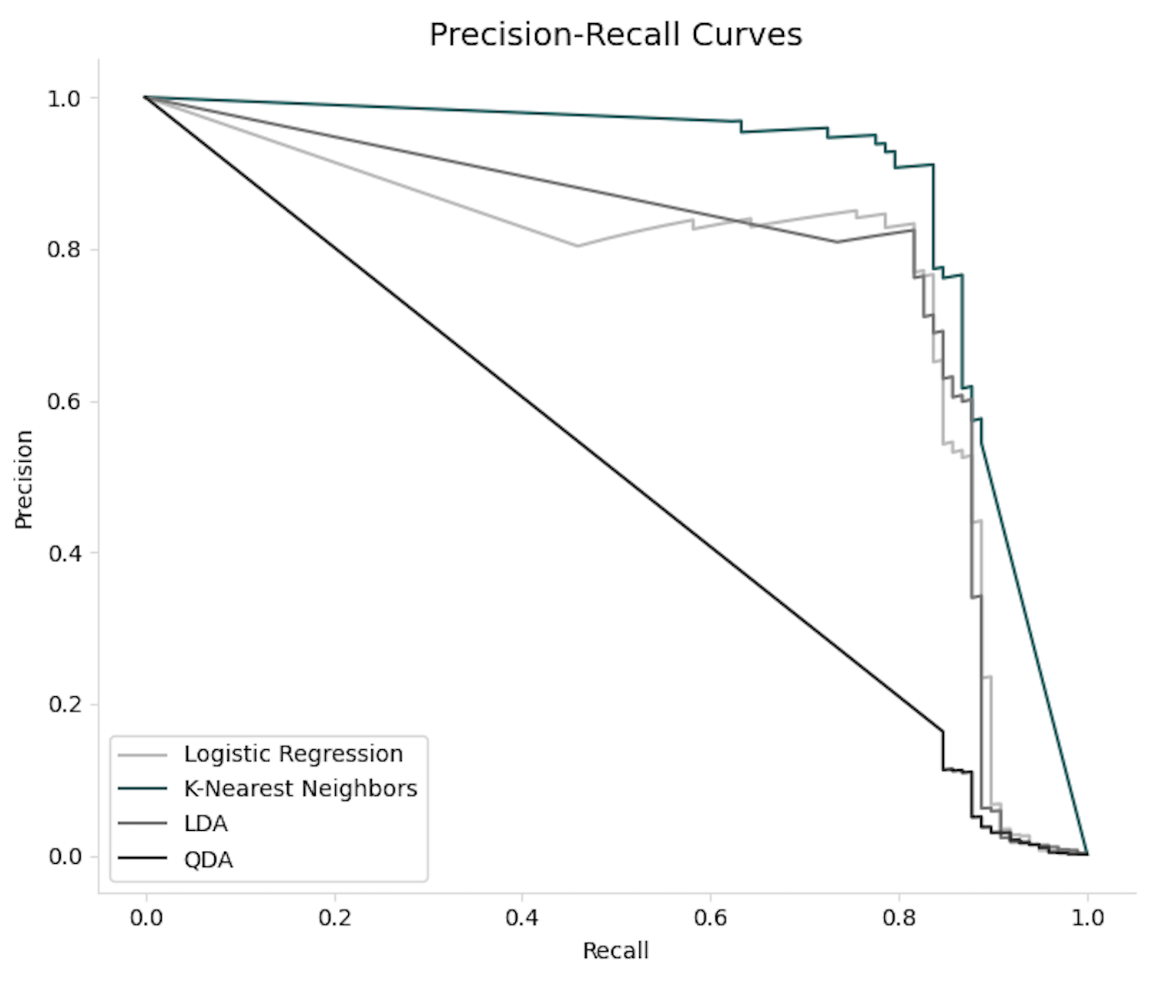
Model Performance
KNN - the best balance of precision and recall
KNN has the highest PR-AUC (0.841)
It catches fraud while keeping false alarms low
Model | Precision | Recall | F1 | ROC-AUC | PR-AUC
KNN | 0.908 | 0.806 | 0.854 | 0.944 | 0.841
LR | 0.056 | 0.908 | 0.106 | 0.972 | 0.714
LDA | 0.823 | 0.806 | 0.814 | 0.981 | 0.708
QDA | 0.061 | 0.878 | 0.114 | 0.964 | 0.144

Slide 12
Model Performance
KNN - the best balance of precision and recall
LDA Fastest
LR Fast
QDA Medium
KNN Slow
KNN delivers the fewest false positives while maintaining strong detection, making it the most reliable model for fraud detection
Model | True Positives | False Positives | False Negatives | True Negatives
KNN | 79 | 8 | 19 | 56,856
LR | 89 | 1,492 | 9 | 55,372
LDA | 79 | 17 | 19 | 56,847
QDA | 86 | 1,327 | 12 | 55,537
Deployment Fit
LDA: Real-time scoring (<100ms)
KNN: Hourly batch re-scoring

Slide 13
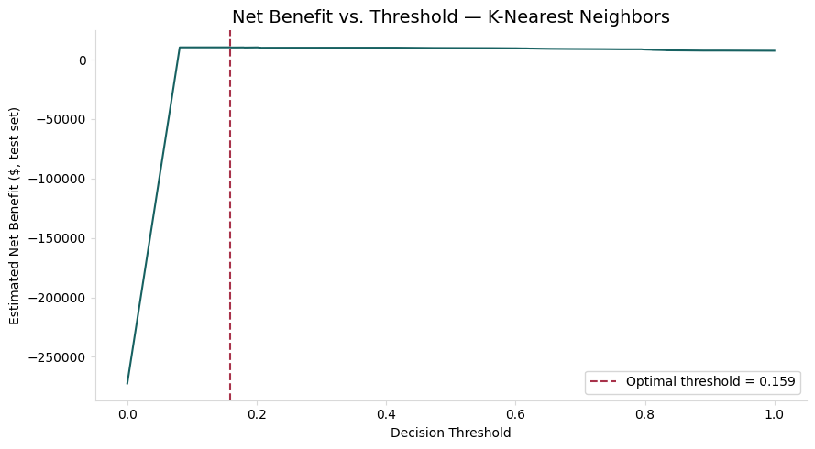
Business Impact
Translating model accuracy into bottom-line saving
$10,312
Net savings on a sample of recent transactions
$50,000
Projected savings across a full 48-hour window

Slide 14
Business Impact
Translating model accuracy into bottom-line saving
Calculation Logic
$10,312
Net savings on a sample of recent transactions
Threshold Optimization
Adjusted the fraud cutoff to catch more fraud without
Optimal cutoff 0.159
$50,000
Projected savings across a full 48-hour window
The math
Fraud losses prevented minus the cost of reviewing flagged transactions
Based on an average fraud loss of $122.21 and an estimated $5.00 cost per manual review

Slide 15
Deployment Strategy
From model training to real-time prevention
Real-time path
Score every transaction in real time
LDA delivers sub-100 ms decisions at the point of sale
Offline path
KNN re-scores recent transactions to catch fraud the real-time model missed
Serialization and integration
Save the trained model and the fitted StandardScaler together
Tunable decision line
The fraud cutoff is a business setting adjusted as review capacity or fraud costs change
Monitoring and retraining
Track live accuracy, detect when fraud patterns shift, and retrain monthly or on detected drift

Slide 16
Lessons Learned and Recommendations
Roadmap for improving model accuracy and business value
What We Learned
• KNN has the highest PR-AUC (0.841) • LDA is fastest (<100ms) • LR and QDA: too many false alarms (1,000+) for operations • Default 0.5 threshold is NOT optimal
Next Steps
• Try XGBoost, Random Forest, Neural Net • Test SMOTE / ADASYN instead of class weights • Replace $5 placeholder with real review costs • Tune threshold for ALL models, not just KNN
Future Enhancements
• Merchant codes, device fingerprinting, geolocation • Longer time window (beyond 48 hours)
Business Extensions
Account Takeover
Anti-Money Laundering

Slide 17
Sources
Kaggle Dataset: Machine Learning Group – ULB. “Credit Card Fraud Detection.” https://www.kaggle.com/datasets/mlg-ulb/creditcardfraud
Dal Pozzolo, A., Caelen, O., Johnson, R. A., & Bontempi, G. (2015). “Calibrating Probability with Undersampling for Unbalanced Classification.” IEEE Symposium Series on Computational Intelligence (SSCI).
Icons: https://fonts.google.com/icons

